Slide 1


Slide 2
LARGE FIRMS | SMALL FIRMS
Banking | Criminal
Business and Corporate | Family
Insurance | Personal Injury
Large litigation | Real Estate
Property development | Small litigation
Tax | Wills and Estates

Slide 3

Sole Practitioner
50 hours a week
30% effective / billable time
At $330 per hour
33% profit
$80K per annum

Slide 4
Paid Online Services - One Lawyer

Slide 5
Three to Five Lawyers

Slide 6
Six to Six Hundred Lawyers

Slide 7
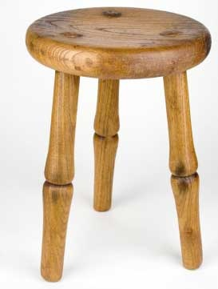
The Law
The Facts
The Practice or Business of Law

Slide 8
A
A
A
A
Availability
Affordability
Affability
Ability
Appearance and perception

Slide 9
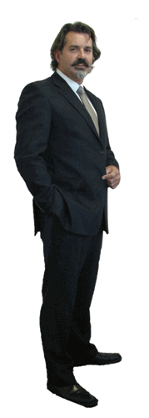
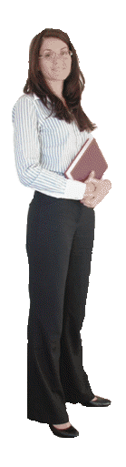
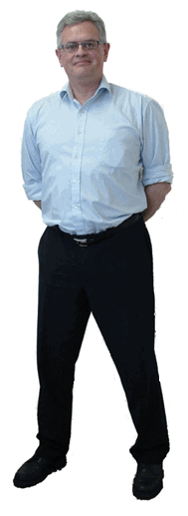
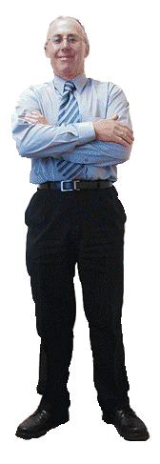
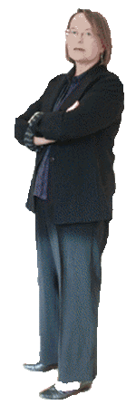
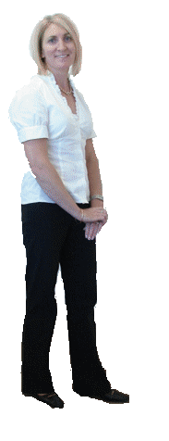
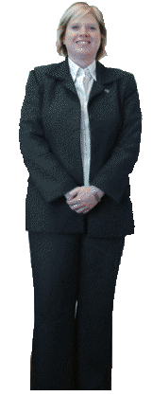
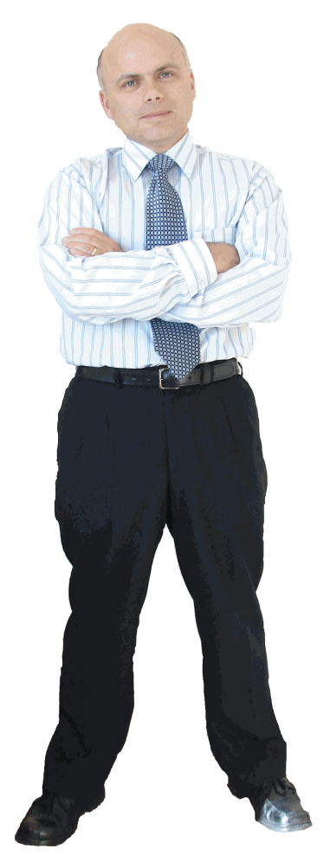
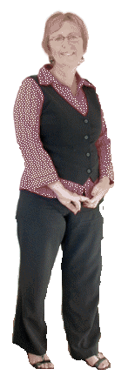
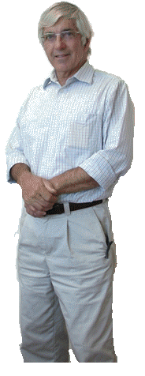

Slide 10

Well resourced before we had the toolkit
Library
CCH individual titles – leasing and tax
LexisNexis package – corporations, procedure, family, IP, forms and precedents, trade practices, Halisbury, Casebase and more
Automation and precedent suites
Practice and procedure manuals
Policies and forms

Slide 11
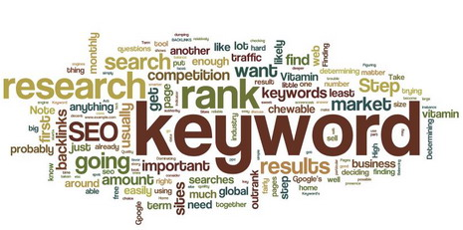

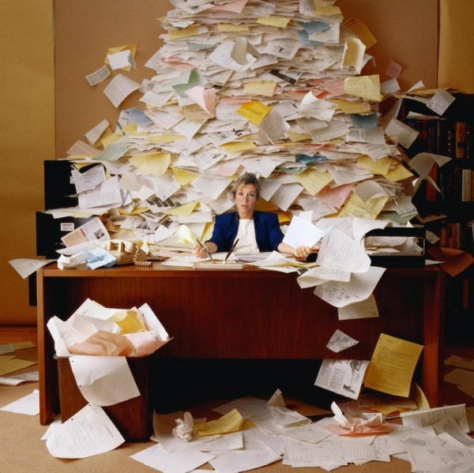

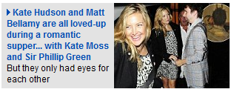
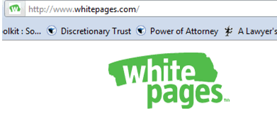

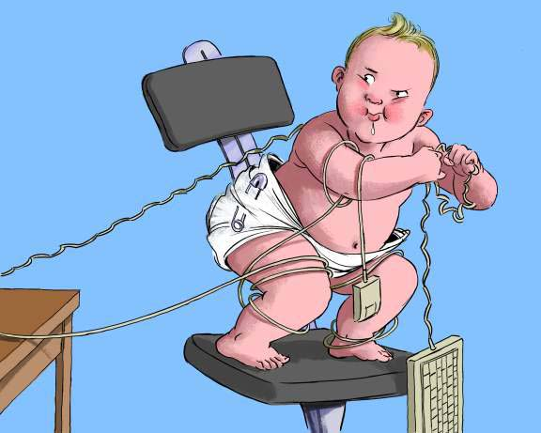
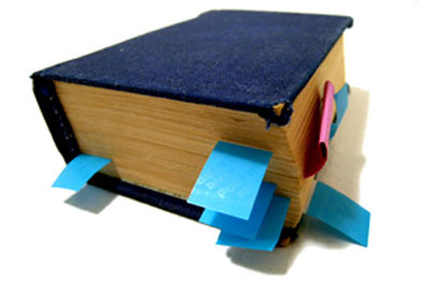

Slide 12

Website of useful information
Started with about 10 pages
500 pages and 16,000 links to free information
5,000 links checked daily
2,000,000 hits a month

Slide 13


Slide 14
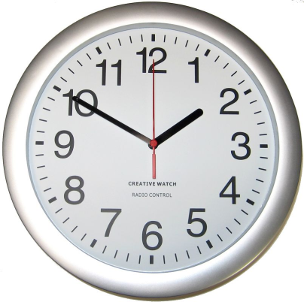
Lawyers saved 30 - 60
Paralegal saved 30
Support staff saved 15 – 30

Slide 15
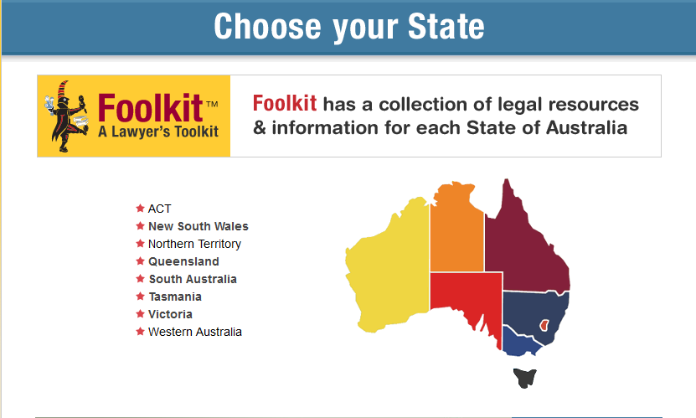
www.foolkit.com.au

Slide 16
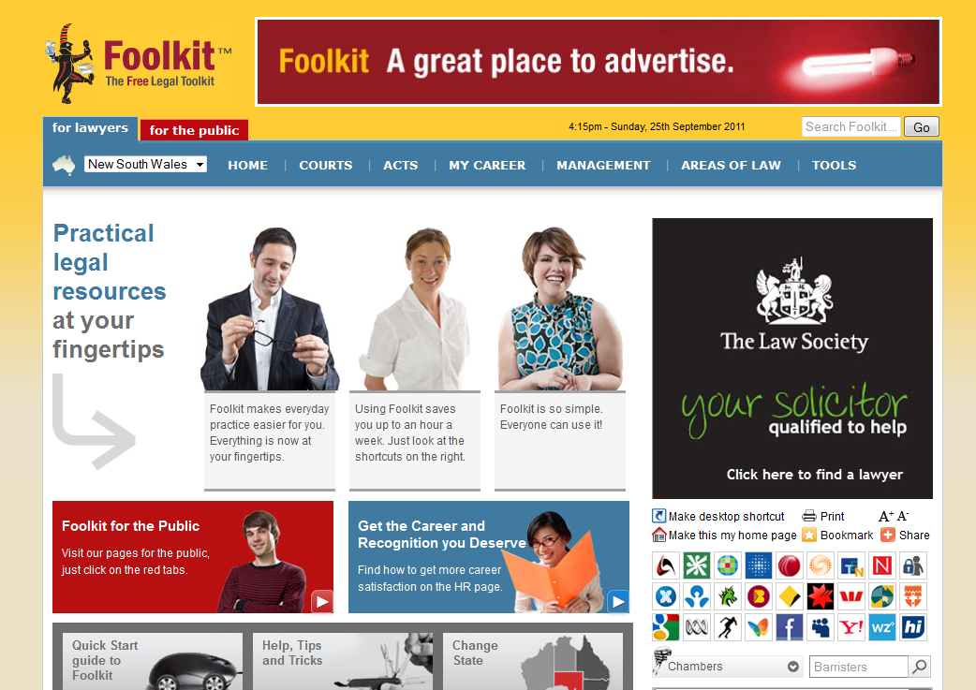

Slide 17
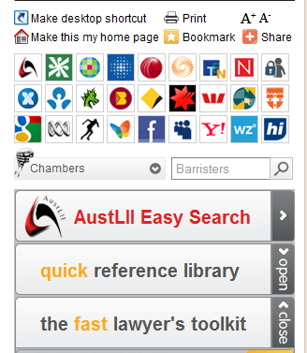

Slide 18
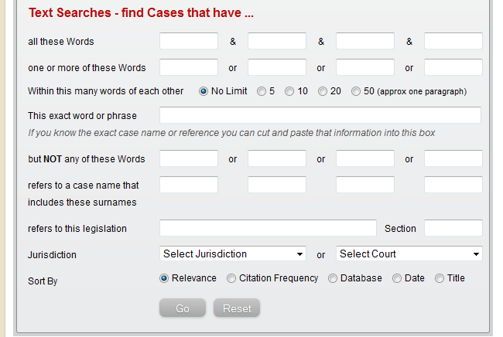

Slide 19
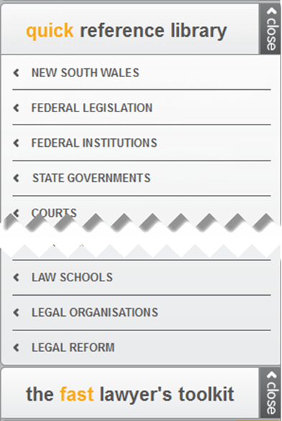

Slide 20
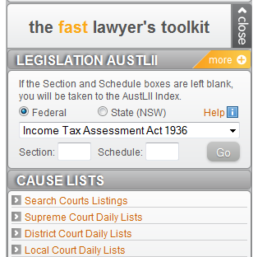

Slide 21
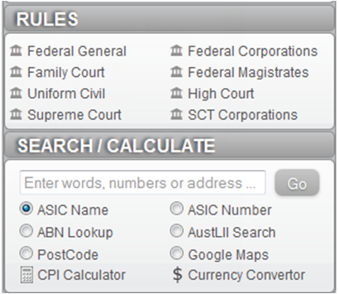

Slide 22
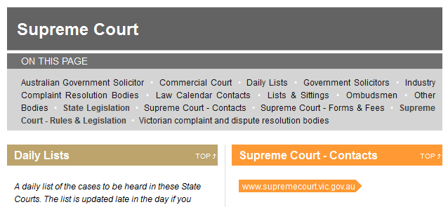

Slide 23
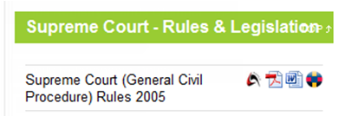

Slide 24
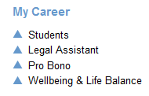
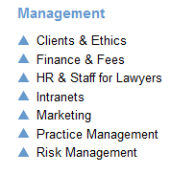

Slide 25
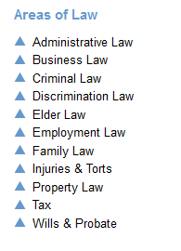

Slide 26
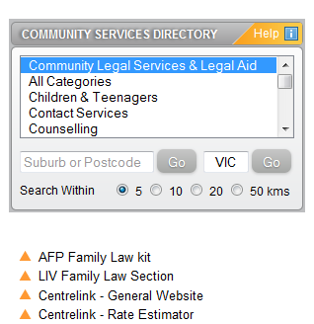

Slide 27
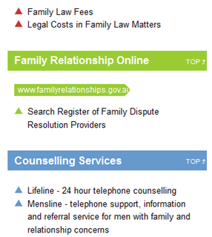

Slide 28
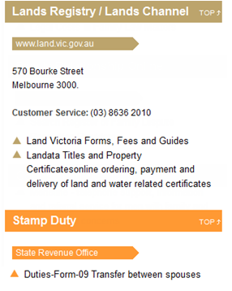

Slide 29
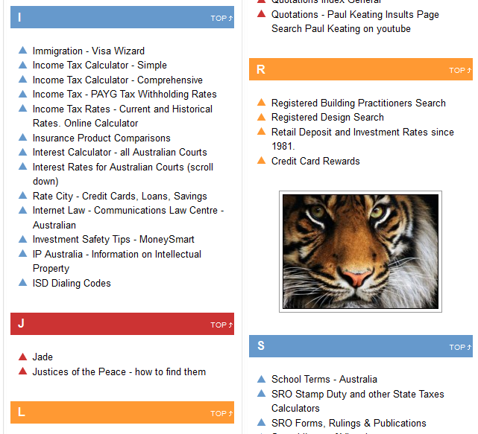

Slide 30
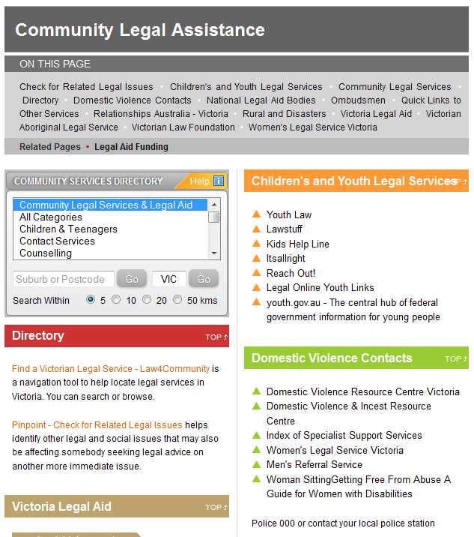

Slide 31
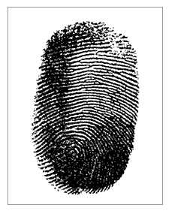

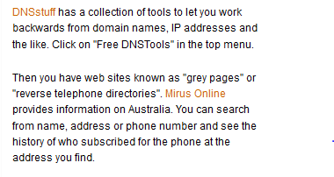


Slide 32
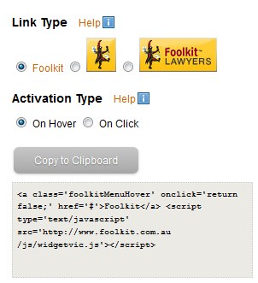

Slide 33
Access to Justice
Helping the ordinary person – not just the poorest of the poor or the well off
Knowing your legal rights and obligations
Avoiding conflict
Finding solutions to problems
Dealing with people who are qualified to help
Accessible
Respectful of what outcome individuals want
Balanced

Slide 34
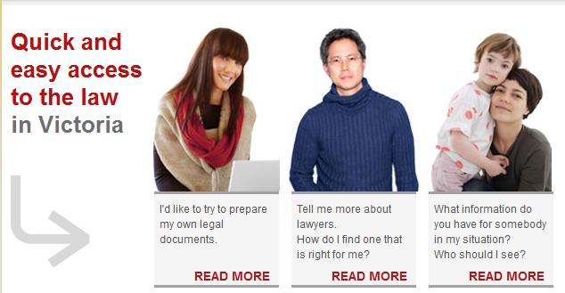

Slide 35
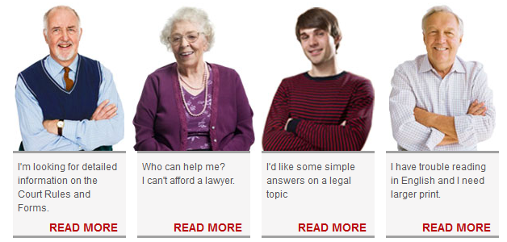

Slide 36
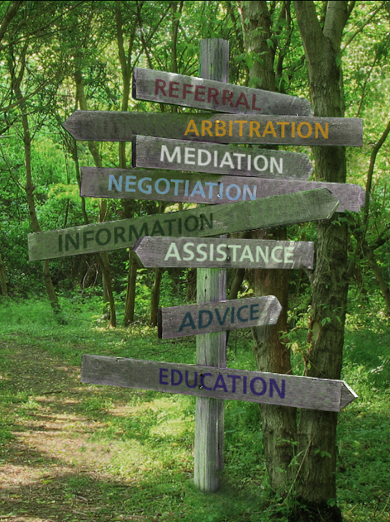

Slide 37
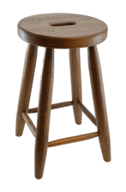
The Law
The Facts
The Practice or Business of Law
Access to Justice
www.foolkit.com.au

Slide 38



Slide 39
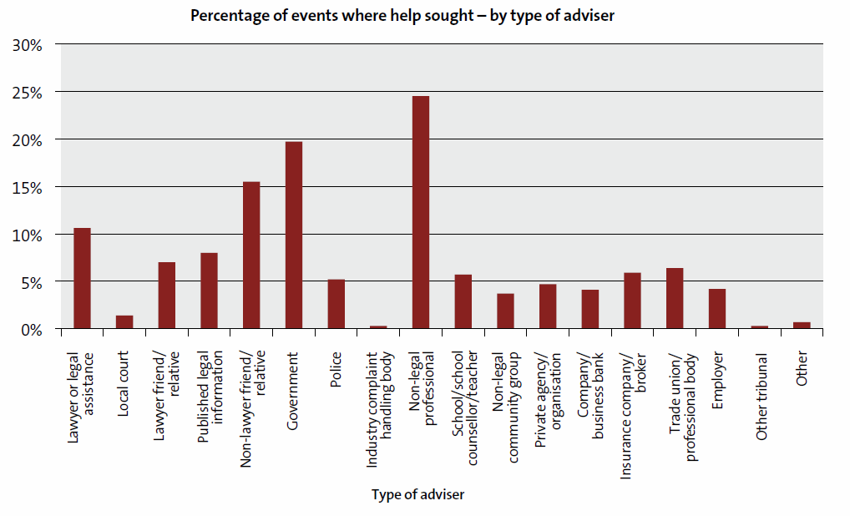

Slide 40
Pick one of the following:
Google
Research websites - AustLII, Jade, CCH, LexisNexis
News, Sport, Weather, White Pages, Newspapers – Facebook
Legislation
Banks
Courts
Law Society
Universities, libraries, legal institutions
Results of user survey by Foolkit of what Home Pages they were using if they were not already using Foolkit.

Slide 41
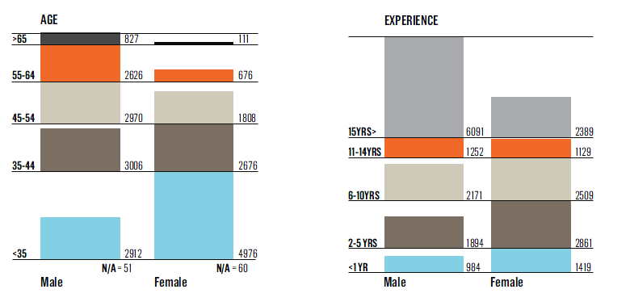

Slide 42
The Skeptic
High Score = skeptical, cynical, judgmental, questioning, argumentative and self-protective.
Low Score = accepting of others, trusting and give other the benefit of the doubt
THE URGENT
High Score = impatience, need to get things done, a sense of immediacy.
Low Score = Patient, contemplative, measured, in no particular rush
RESILIENCE
An individual's tendency to cope with stress and adversity.
Low Score = defensive, resist taking in feedback and can be hypersensitive to criticism.
THE SOCIABLE
High Score = A desire to interact with people, especially a comfort level in initiating new, intimate connections with others.
Low Score = prefer to spend more time dealing with information.

Slide 43
The Skeptic
95th percentile
THE URGENT
70% percentile
RESILIENCE
30th percentile
THE SOCIABLE
12.8%, vs. 50% for the general public.

Slide 44
